Slide 1
Chapter 5: Measures of Dispersions
Part-2

Slide 2
Contents
    From this lecture, you are going to learn…
Discussion on sample variance and sample standard deviation with maths.
Coefficient of Variation (C.V.)
Exercises

Slide 3

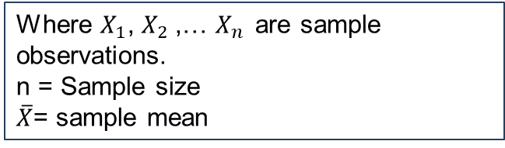
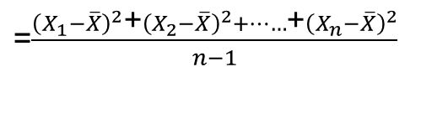
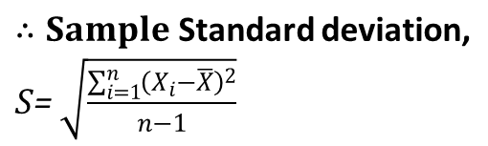
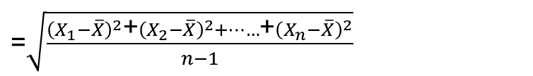
Sample Variance and Standard Deviation
Why Sample standard deviation?
When entire information of the population will not be available and need to draw conclusion based on sample we use sample standard deviation .

Slide 4
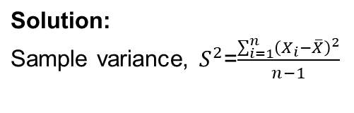


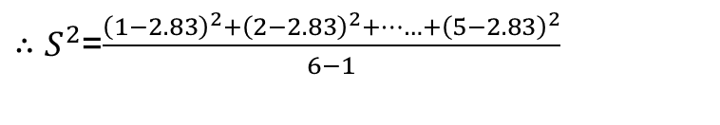

Example of Sample Variance and Standard Deviation
Example: Calculate the Sample variance and standard deviation for the data set 1, 2, 2, 3, 4, 5.
= 2.83

Slide 5

Merits and limitations of
Standard Deviation
Merits of Standard Deviation:
Among all measures of dispersion Standard Deviation is considered superior because it possesses almost all the requisite characteristics of a good measure of dispersion.
1) It is based on all the observations of the data set.
3) It is amenable to further mathematical calculation.
Limitations:
1) It is more affected by extreme items.

Slide 6
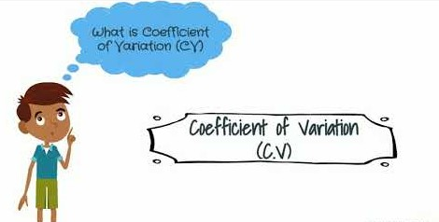

Relative measure:
Coefficient of Variation(c.v.)
Coefficient of Variation expresses the standard deviation as a percentage of the mean.

Slide 7
Relative measure:
Coefficient of Variation(c.v.)
Purposes of studying coefficient of variation(C.V):
To compare the variability of two or more data sets.
To compare the Consistency, Uniformity, Homogeneity, Stability of two or more data sets.
Since c.v. is a unit free measure, we can compare two or more data sets having different units.
High c.v.
High variability
High consistency
High uniformity
High homogeneity
High stability
Low c.v.

Slide 8
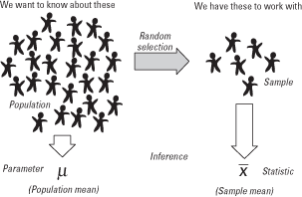
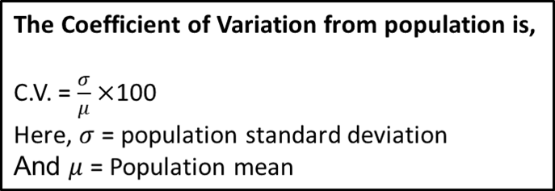
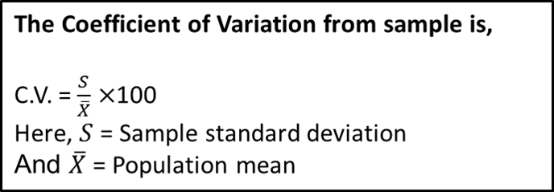
Relative measure:
Coefficient of Variation(c.v.)

Slide 9
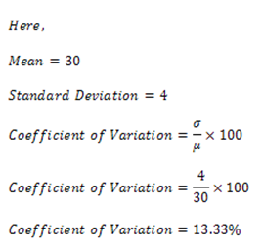
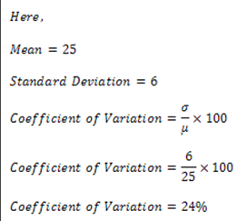
Relative measure:
Coefficient of Variation(c.v.)
Example: The mean final exam marks of Section A is 30 out of 40 with standard deviation 4 and the mean final exam marks of Section B is 25 out of 40 with standard deviation 6.
Which Section is more consistent in getting final exam marks?
Solution:
For the students of section A,
For the students of section B,
Since c.v. of section A is less than c.v. of section B, so section A is more consistent in getting their final exam marks.

Slide 10
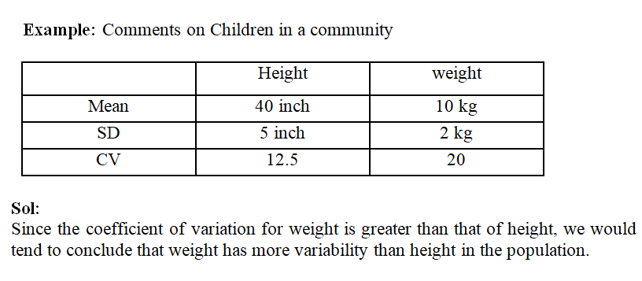
Example
For better understanding of c.v. you can watch this link:
https://www.youtube.com/watch?v=gUkeVA6iD8s

Slide 11
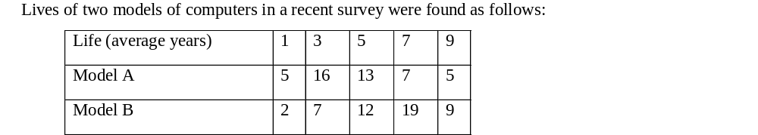
Exercises to solve
The thickness of printed circuit board is very important characteristics. A sample of 10 boards had the following thickness (in thousands of an inch) :
61 65 62 61 64 60 66 68 61 63
Find the mean, standard deviation and coefficient of variation for the given data.
i. What is the average life of each model of these computers?
ii. Which of the two models shows more uniformity?

Slide 12


